Slide 1
Regular Expression

Slide 2
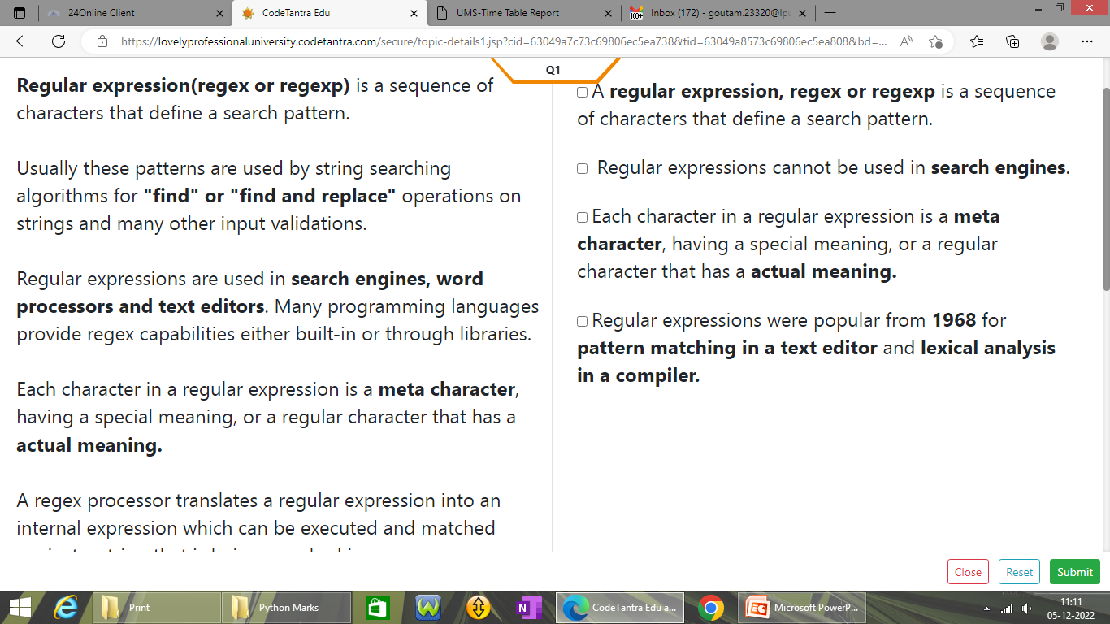
What is Regular Expression?

Slide 3
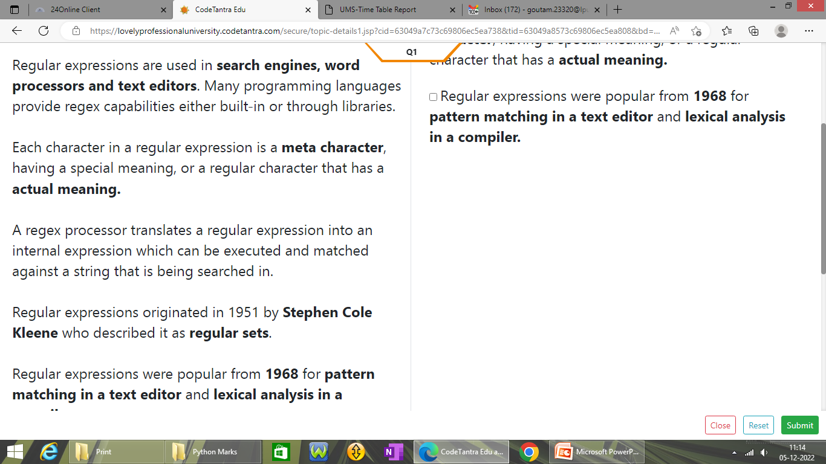
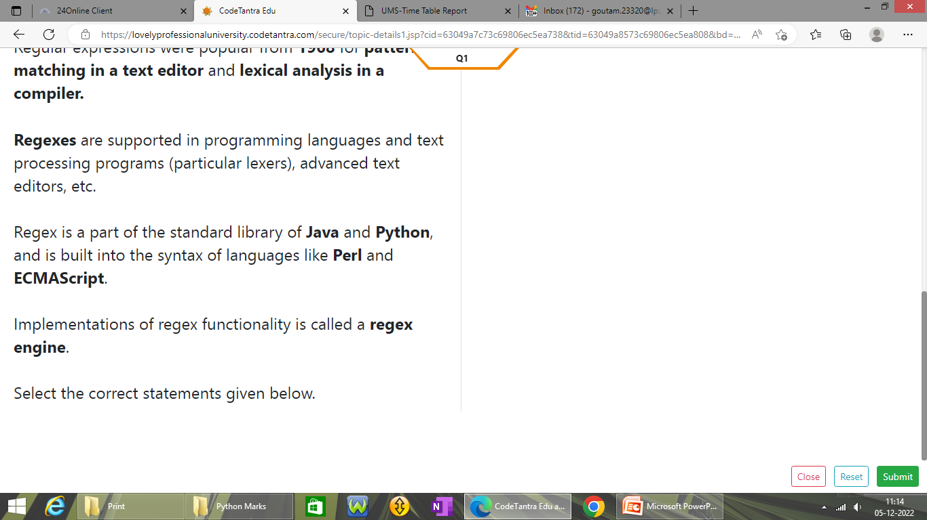
What is Regular Expression?

Slide 4
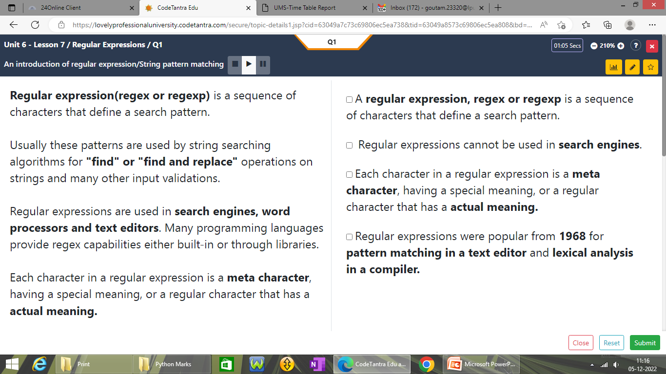
Find the Correct Solution

Slide 5
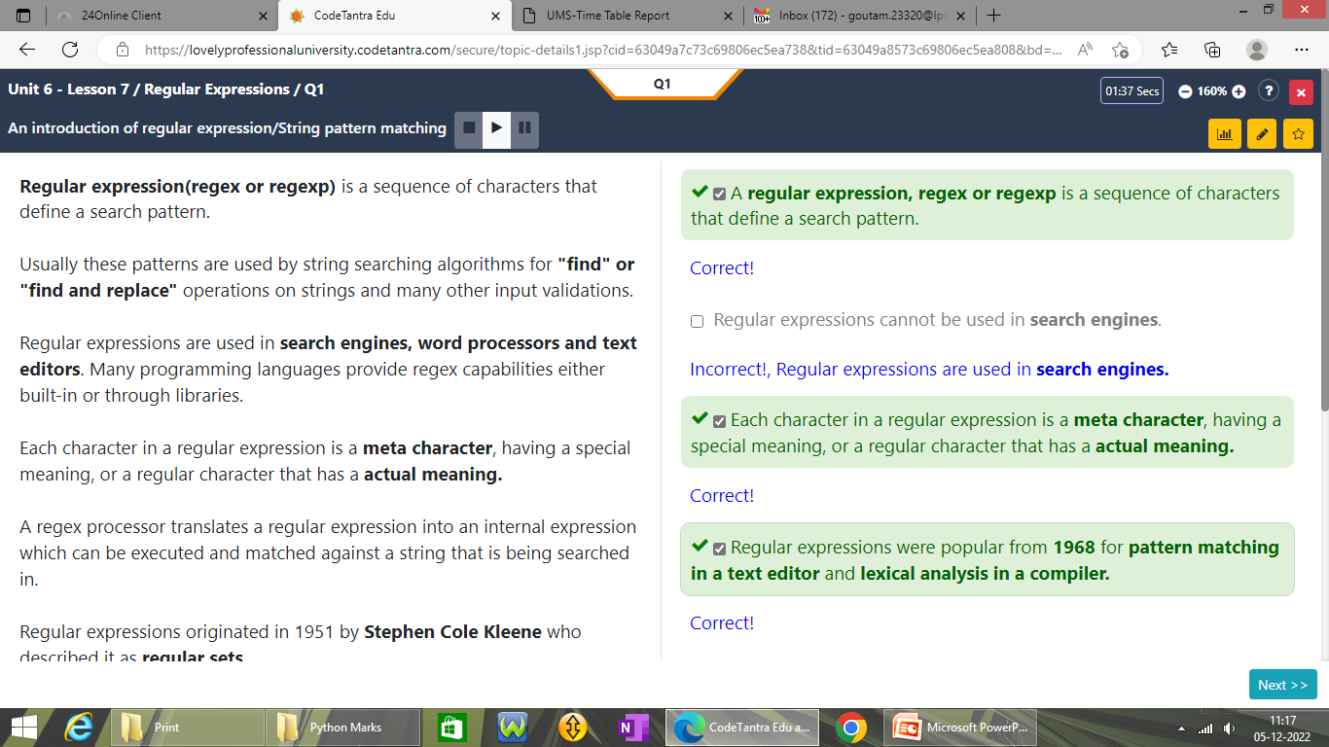
Find the Correct Solution

Slide 6
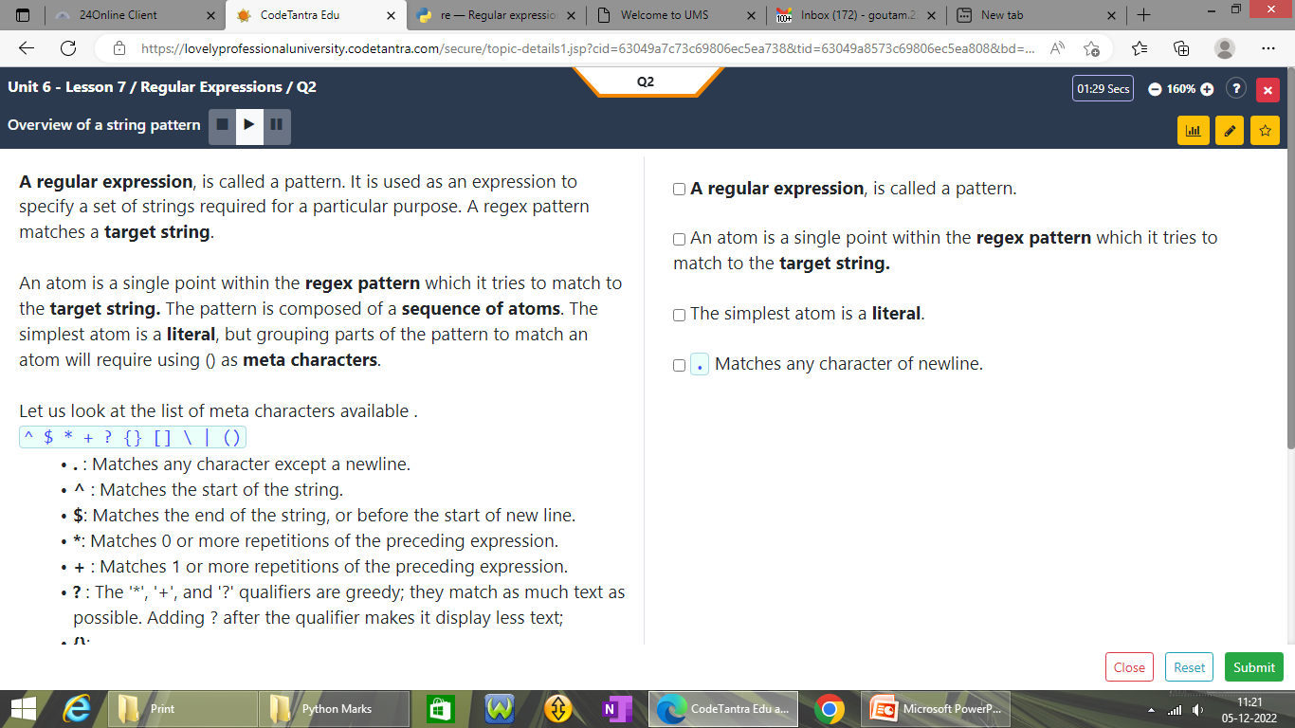
List of Meta characters used for RE

Slide 7
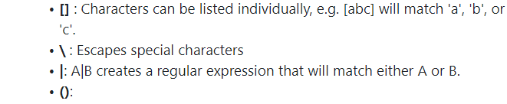
List of Meta characters used for RE

Slide 8
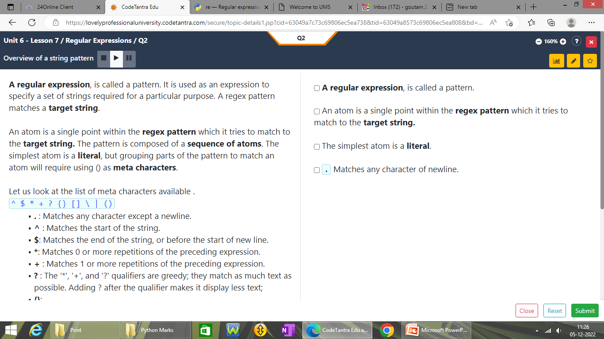
Find the Correct Solution

Slide 9
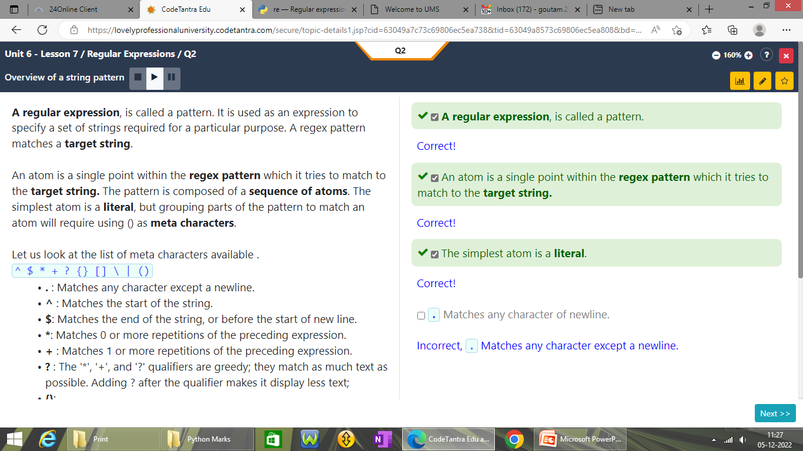
Find the Correct Solution

Slide 10
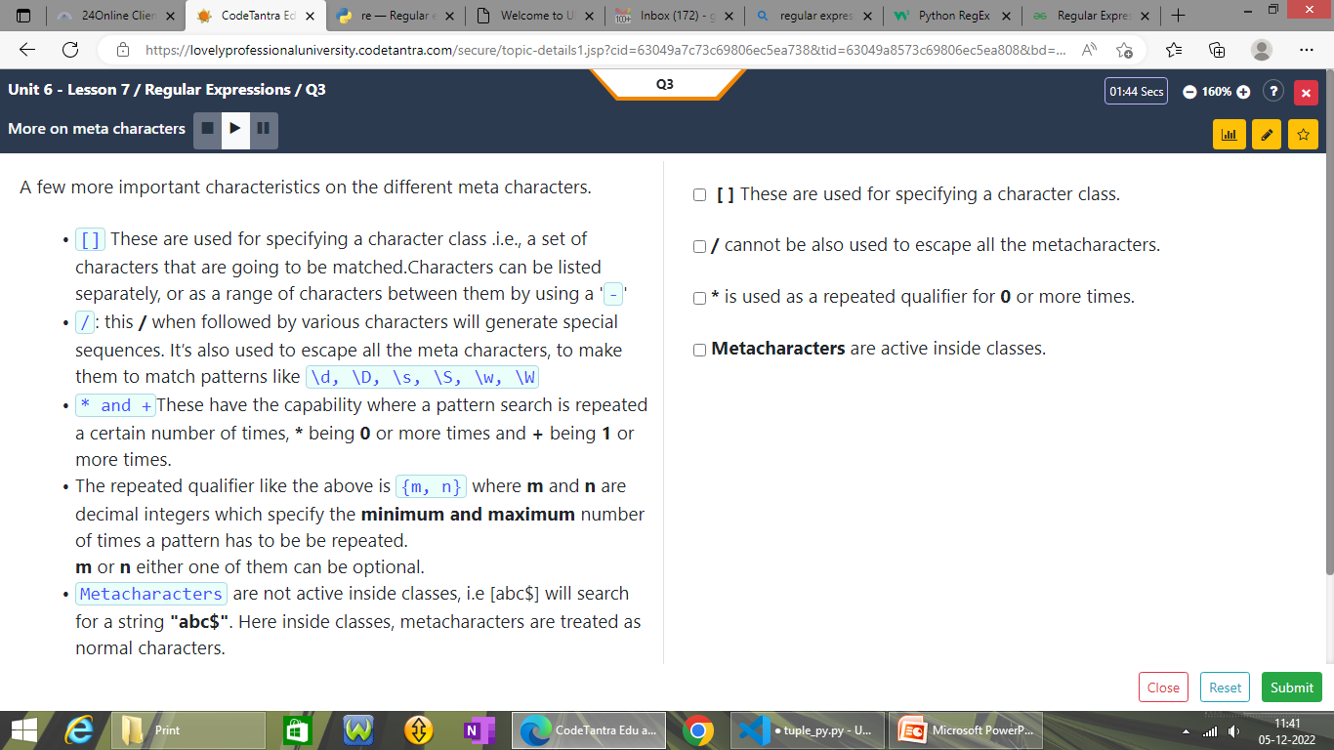
About meta characters

Slide 11

Find the Correct Solution

Slide 12
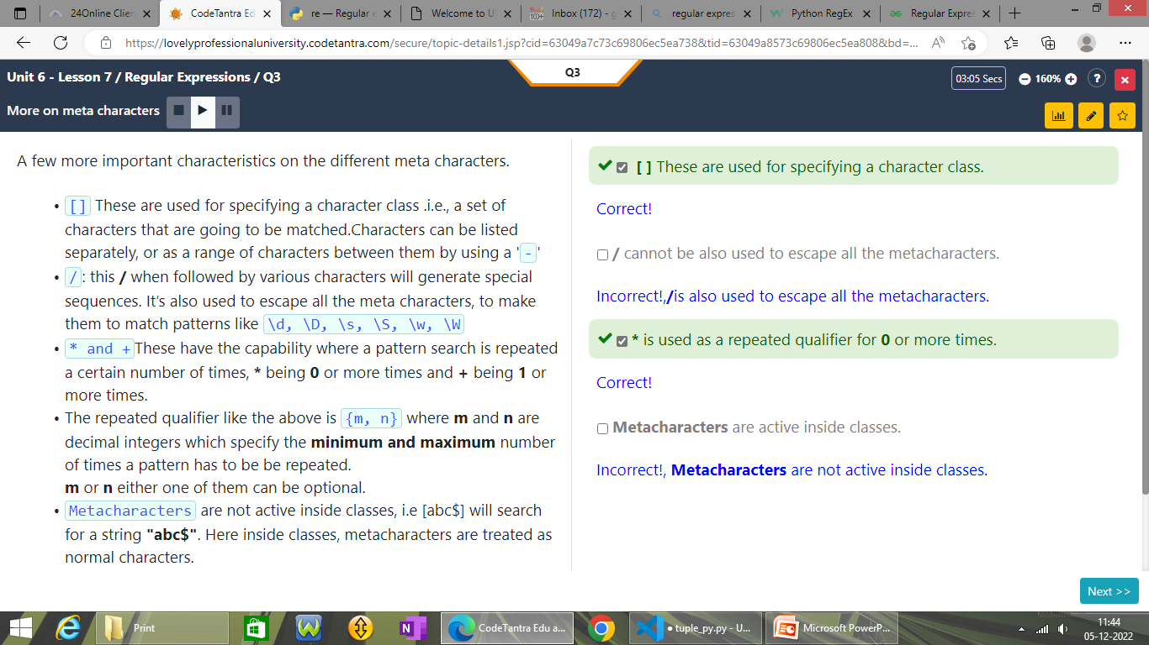
Find the Correct Solution

Slide 13
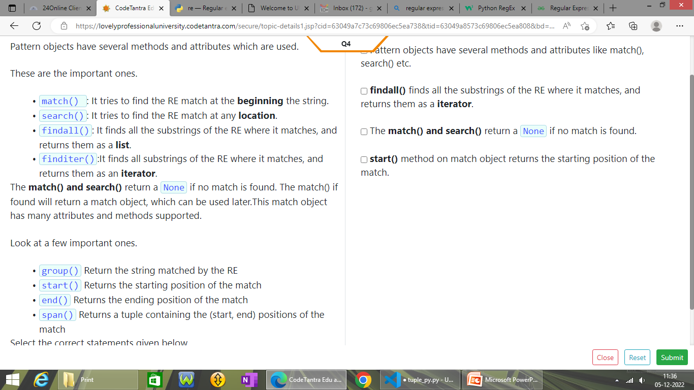
List of Pattern Object Methods

Slide 14
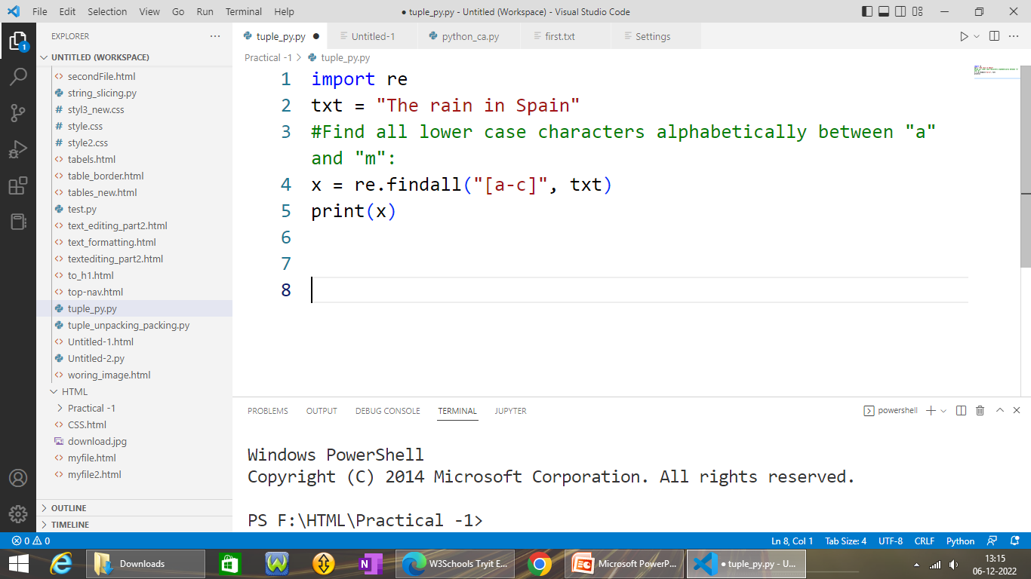
A set of characters []

Slide 15
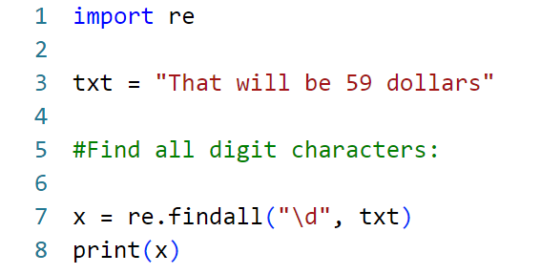
Find all digits

Slide 16
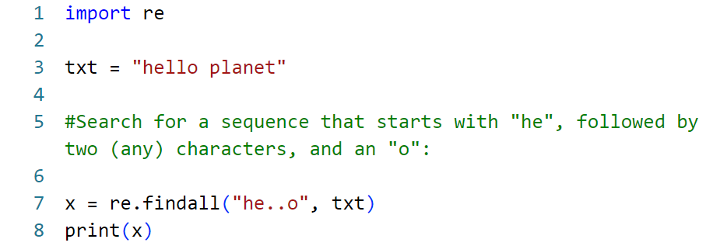
Search any character (except newline character)

Slide 17
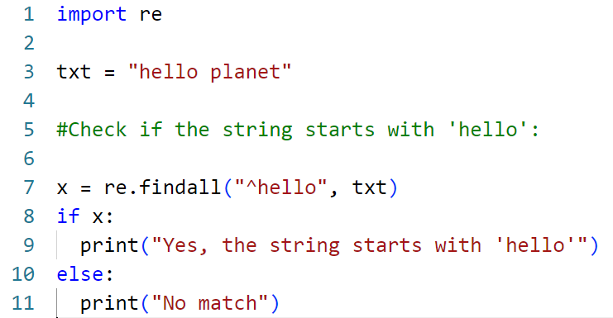
Starts with meta character (^)

Slide 18
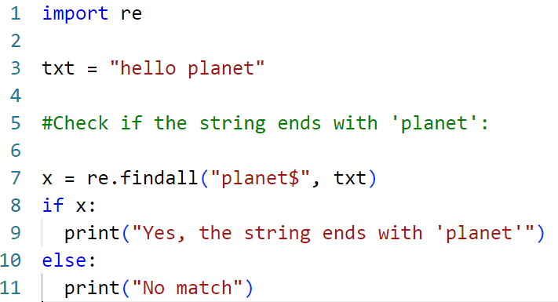
Ends with meta character ($)

Slide 19
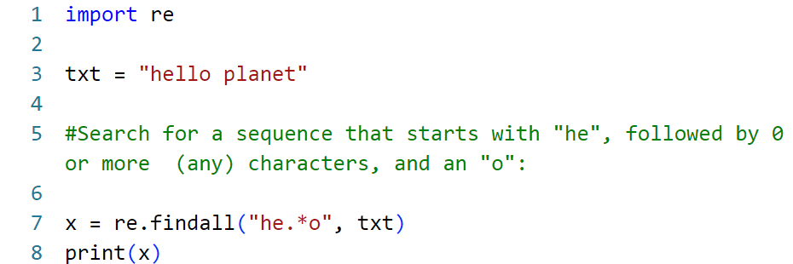
Zero or more occurrences (*)

Slide 20
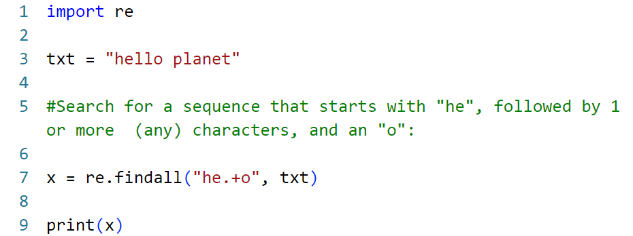
One or more occurrences (*)

Slide 21
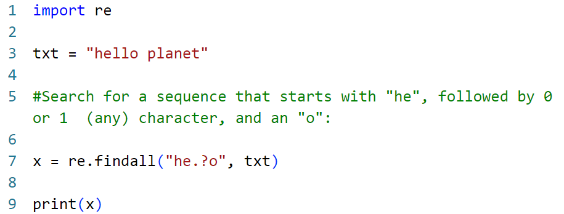
Zero or one occurrences (?)

Slide 22
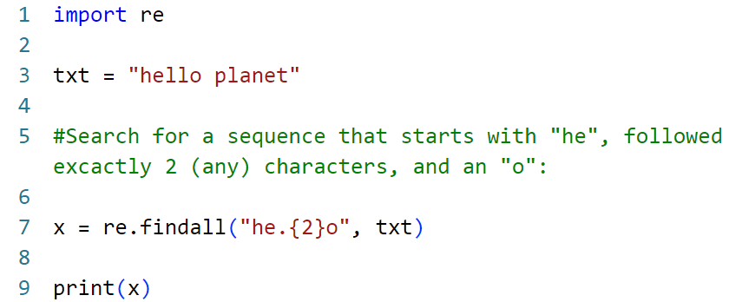
Exactly Specified number of characters

Slide 23
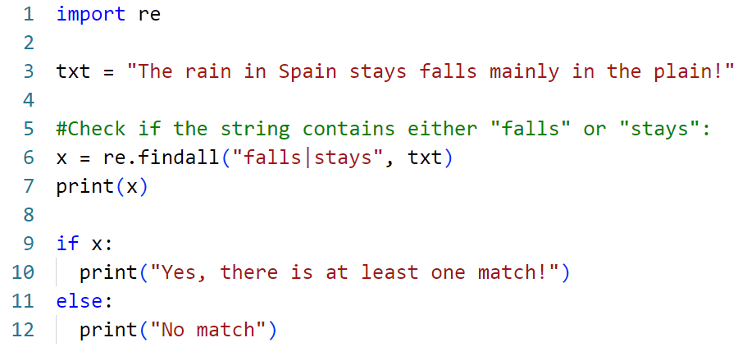
Either or

Slide 24
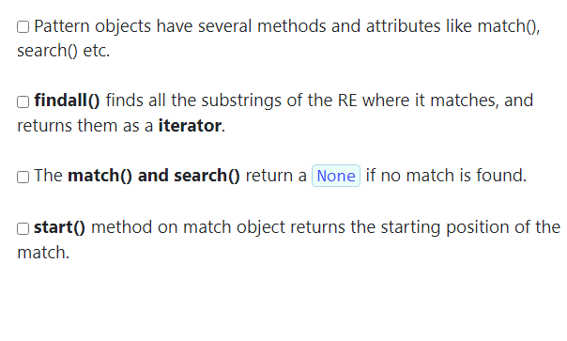
Find the Correct Solution

Slide 25
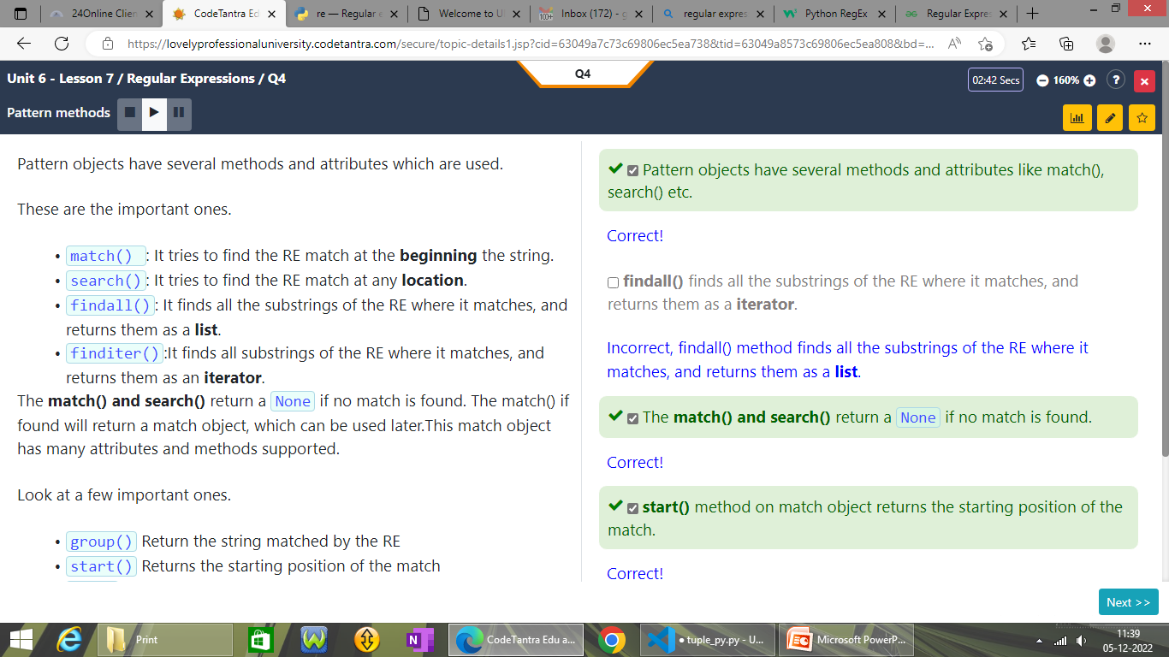
Find the Correct Solution

Slide 26
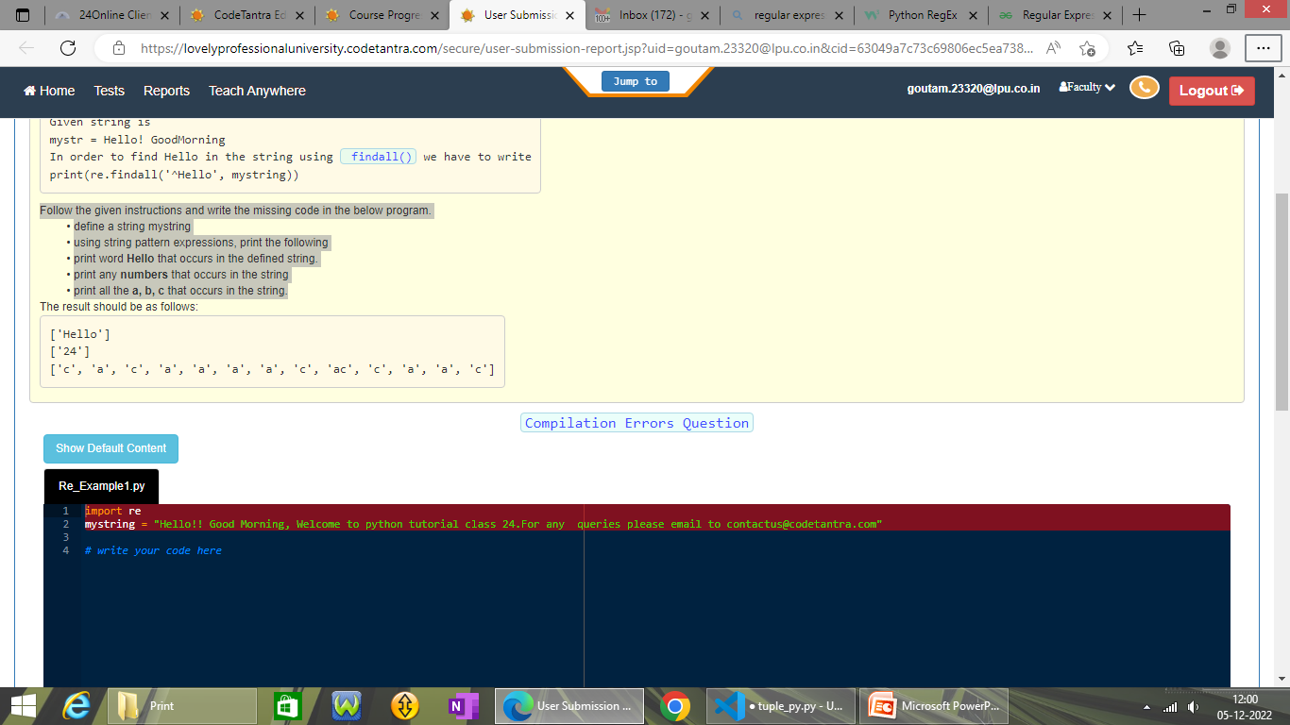
Solve This
Follow the given instructions and write the
define a string mystring
using string pattern expressions, print the following
print word Hello that occurs in the defined string.
print any numbers that occurs in the string
print all the a, b, c that occurs in the string.

Slide 27
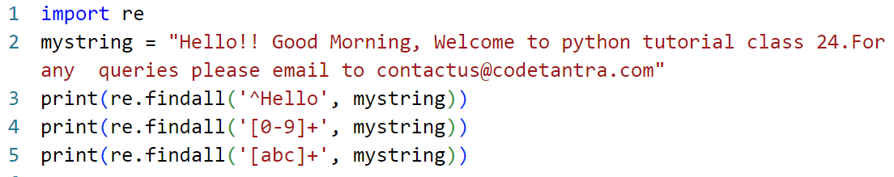
Solution

Slide 28
Solve This
use the findall() function on it.
Define mystring "Hello!! Good Morning, Welcome to python tutorial class 24."
Call the findall() method by passing the regular expression that finds e, o occurrences in the mystring.
Store the list elements in a variable matches
Iterate through the list using for loop and print all the occurrences of e, o that are returned in matches.

Slide 29
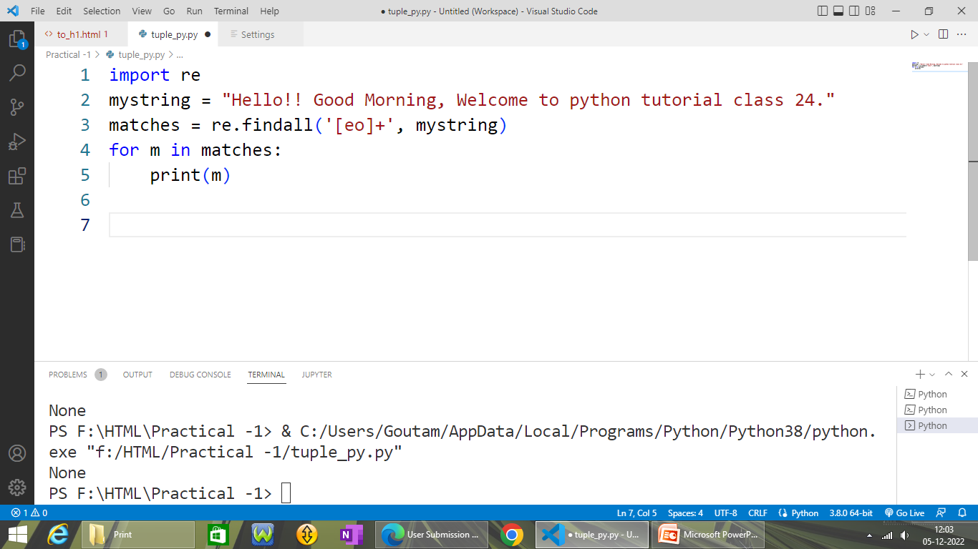
Solution

Slide 30
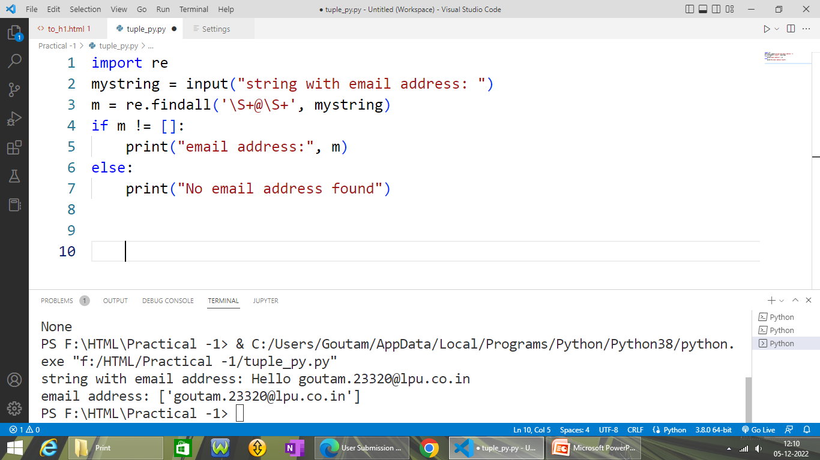
Solve This
Write a pattern that searches for a email address in a given string.

Slide 31
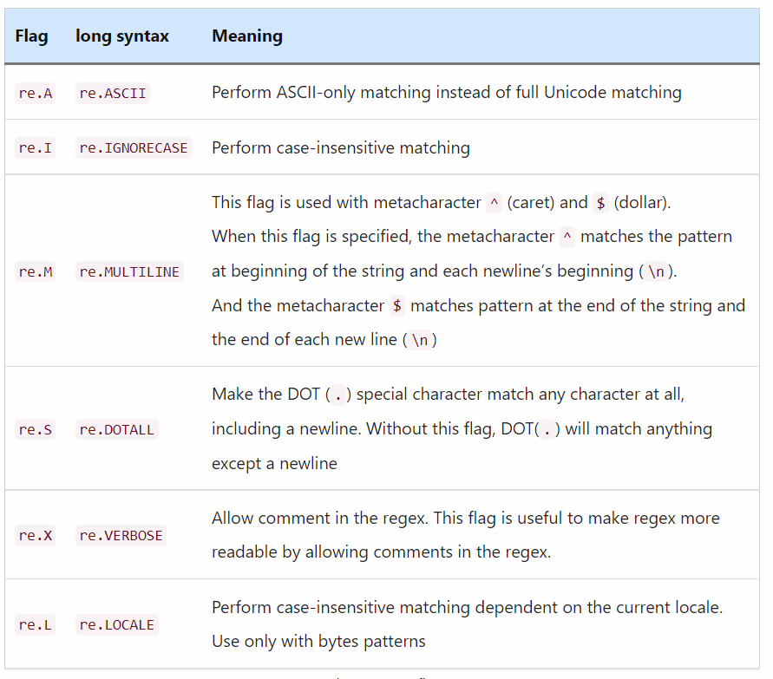
Use of flags in regular expression

Slide 32
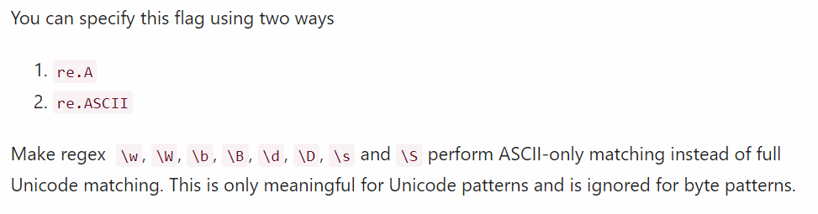
ASCII Flag
\b – defines the word boundary
\A – Matches only start of the string
\d – Matches the digits only
\S – Matches the whitespace characters

Slide 33
ASCII Flag
import re
# string with ASCII and Unicode characters
target_str = "虎太郎 and Jessa are friends"
# Without re.A or re.ASCII
# To match all 3-letter word
result = re.findall(r"\b\w{3}\b", target_str)
print(result)
# Output ['虎太郎', 'and', 'are']
# With re.A or re.ASCII
# regex to match only 3-letter ASCII word
result = re.findall(r"\b\w{3}\b", target_str, re.A)
print(result)
# Output ['and', 'are']

Slide 34
Ignore Case Flag (re.I or IGNORECASE)
import re
target_str = "KELLy is a Python developer at a PYnative. kelly loves ML and AI"
# Without using re.I
result = re.findall(r"kelly", target_str)
print(result)
# Output ['kelly']
# with re.I
result = re.findall(r"kelly", target_str, re.I)
print(result)
# Output ['KELLy', 'kelly']
# with re.IGNORECASE
result = re.findall(r"kelly", target_str, re.IGNORECASE)
print(result)
# Output ['KELLy', 'kelly']

Slide 35
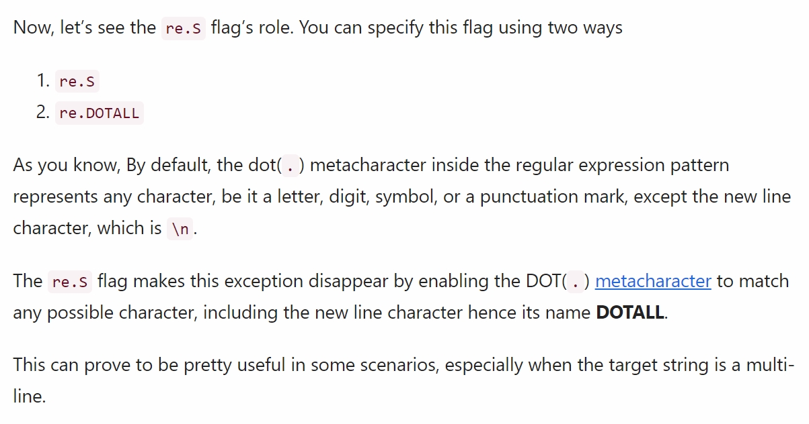
.DOTALL or .S

Slide 36
.DOTALL or .S
import re
# string with newline character
target_str = "ML\nand AI"
# Match any character
result = re.search(r".+", target_str)
print("Without using re.S flag:", result.group())
# Output 'ML'
# With re.S flag
result = re.search(r".+", target_str, re.S)
print("With re.S flag:", result.group())
# Output 'ML\nand AI'
# With re.DOTALL flag
result = re.search(r".+", target_str, re.DOTALL)
print("With re.DOTALL flag:", result.group())
# Output 'ML\nand AI'

Slide 37
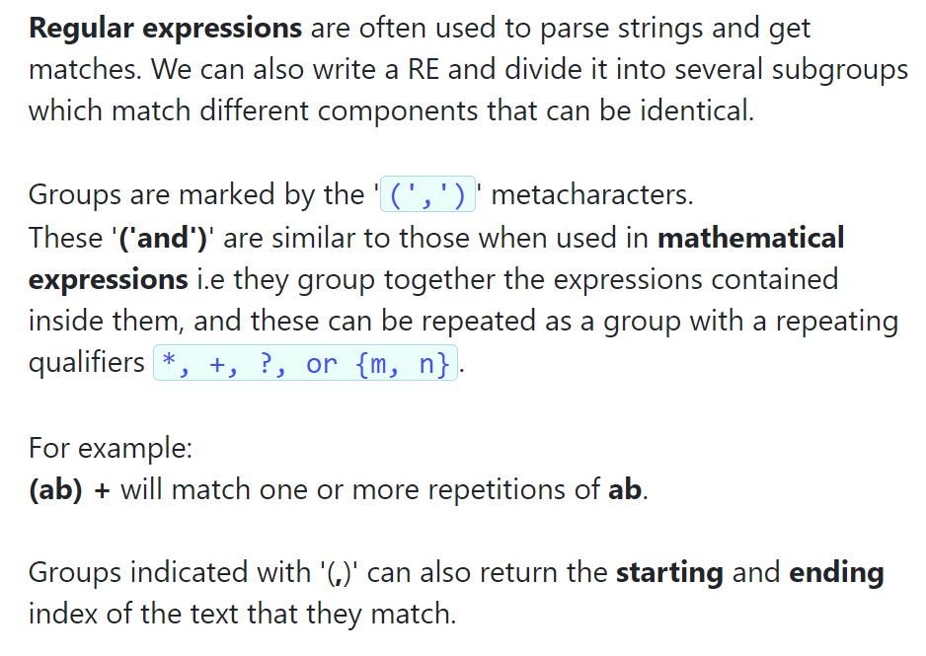

Slide 38
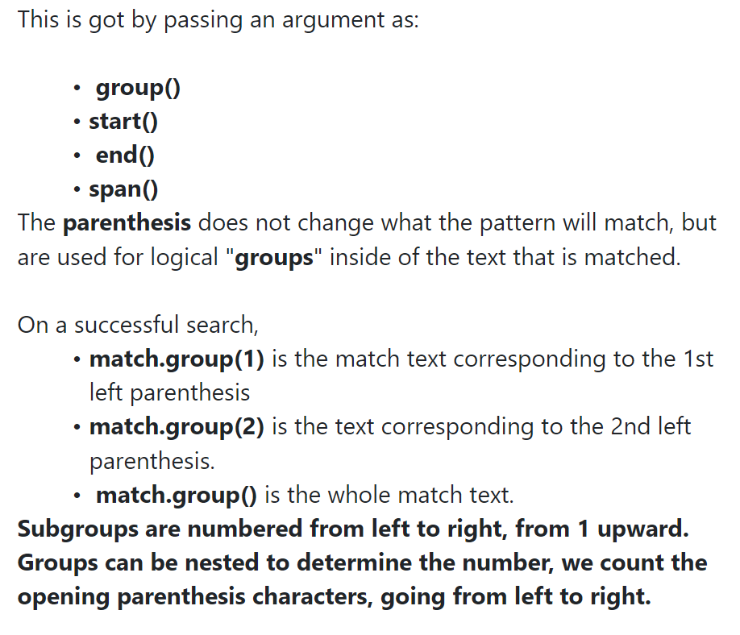

Slide 39
import re
mystring = "The alternate email address is victory@ct.com"
match = re.search('(\w+)@(\w+).(\w+)', mystring)
if match:
# find full match text and print the result
print("Full match:", match.group())
# find the match text corresponding to the 1st left parenthesis and print
print("Group 1:", match.group(1))
# find the match text corresponding to the 2nd left parenthesis and print
print("Group 2:", match.group(2))
# find the match text corresponding to the 3rd left parenthesis and print
print("Group 3:", match.group(3))

Slide 40
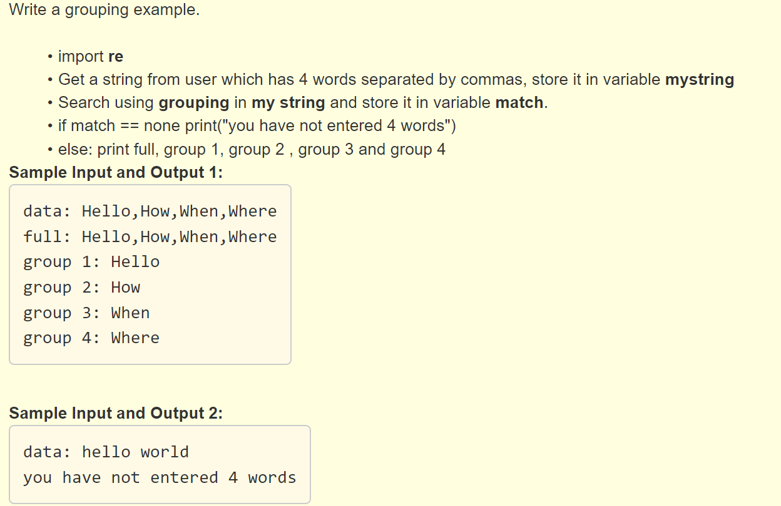

Slide 41
import re
mystring = input("data: ")
match = re.search('(\w+),(\w+),(\w+),(\w+)', mystring)
if match == None:
print("you have not entered 4 words")
else:
print("full:", match.group(0))
print("group 1:", match.group(1))
print("group 2:", match.group(2))
print("group 3:", match.group(3))
print("group 4:", match.group(4))

